Slide 1
Machine Learning II Final Project
Violence & Non-Violence Video Detection through neural network
Group 8
Changhao Ying, Spencer Staub, Hongfei Niu

Slide 2
Introduction
Dataset
Exploratory Data Analysis
Preprocessing
Networks
Multilayer Perceptron
Convolutional Neural Networks (CNN)
Pretrained CNN
Time Distributed CNN + Long Short-Term Memory (LSTM)
Summary
Conclusion
Limitation
Improvement
Reference

Slide 3
Introduction
Dataset
RWF-2000 Violence detection database
2000 videos captured from surveillance cameras
Classified into violent or non-violent videos
Objective
Create a network with binary classification
Utilize networks to quickly classify violence in order to alert authorities
Utilize various MLP, CNN and RNN networks
Challenges
Extremely large data source with limited computing power
Preprocessing and deploying networks on video data (multiple frames)

Slide 4
Dataset
Raw Video Clips from Surveillance videos on Youtube
5 Seconds long
30 Frames Per Second
*.avi format
Downloaded as an ~11GB zip file resulting in ~120GB in video files
2000 Total Videos
Separated into Violence/Nonviolence
Seperated Into an 80/20 Train/Test Split
Ming Cheng, Kunjing Cai, and Ming Li. "RWF-2000: An Open Large Scale Video Database for Violence Detection." arXiv preprint arXiv:1911.05913 (2019).

Slide 5

Video Description
Poor quality:
Dark Environments
Low Resolution
Low Frames Per Second
Quick Moving Objects
Non-Color Video
Blur
Image Obstruction
Format
Large Crowds
One-on-One Interaction
Conflict partially in frame
Conflict Far Away

Slide 6
Preprocess
Transfer all the videos into npy and save them into ubuntu directory
149 frames per video
Use cv2 resize to (224,224), (100,100) or (64,64) depending on the memory requirement of each network
Create 3RGB and 2 OPT for each frame
Normalize data using Mean and Standard Deviation
Downsample 149 frames to 28 frames depending on the memory requirement of each network
Reshape to work with various network input shapes
Create categorical labels based off of video file location (1,0)

Slide 7
Models & Analysis
MLP
CNN
Conv1D
Resnet50 (pretrained)
EfficientNet-B0 (pretrained)
VGG-16 (pretrained
RNN
Time Distributed Conv2D with LSTM

Slide 8
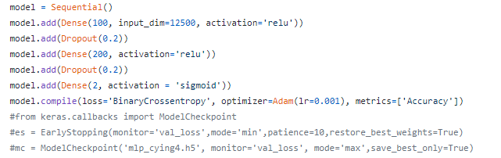
MLP Model
Setup
Input Shape: (Batch*149*50*50*5)
Train/Test: 64/16 videos or 9536/2384 Frames
Scale Train/Test with batch size=512
Network

Slide 9
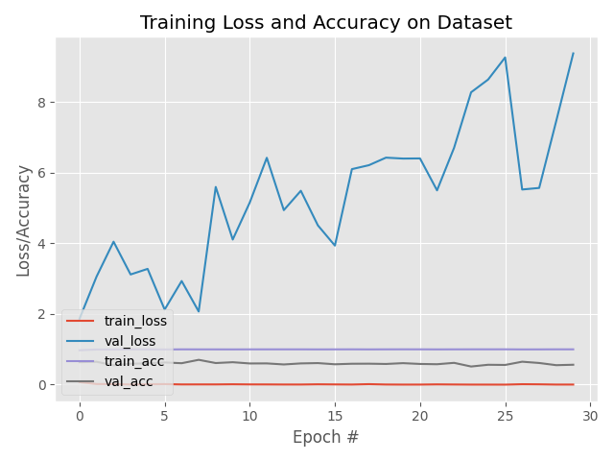
MLP Model Results
Validation Accuracy: 56.33%
F1 Score: 0.56
Cohen Kappa: 0.12
Confusion Matrix: Loss/Accuracy Graph:
Actual
n = 2384 | Positive | Negative
Positive | 554 | 638
Negative | 403 | 789
Predicted

Slide 10
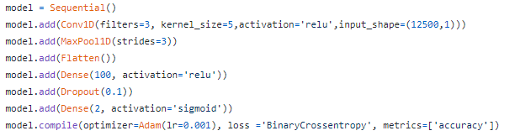
Conv1D Model
Setup
Input Shape: (Batch*149*50*50*5*1)
Train/Test: 64/16 videos or 9536/2384 Frames
Scale Train/Test with batch size=4
Network

Slide 11
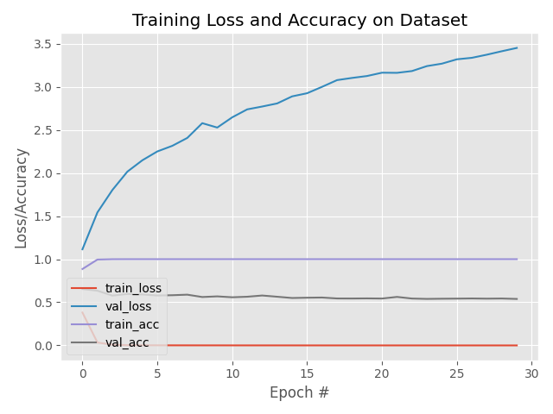
Conv1D Model Results
Validation Accuracy: 53.9 %
F1 Score: 0.52
Cohen Kappa: 0.078
Confusion Matrix: Loss Graph:
Actual
n = 2384 | Positive | Negative
Positive | 464 | 728
Negative | 371 | 821
Predicted

Slide 12
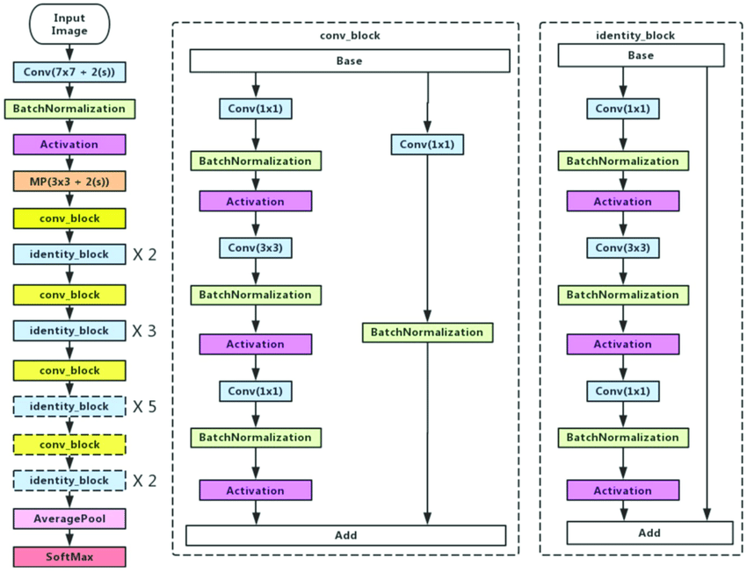
ResNet50 Model Description
Convolutional Neural Network
50 Layers
Pretrained on ImageNet Dataset
Input shape of (224,224), but our input of (64,64) works well too

Slide 13
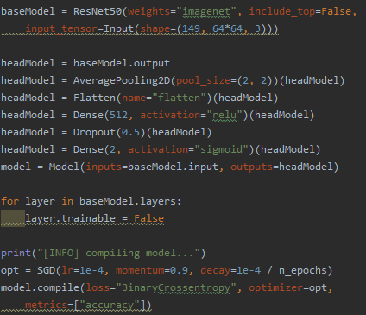
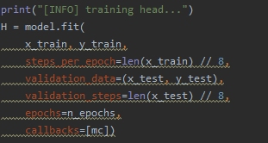
ResNet50 Model
Setup
Input Shape: (149,64*64,3)
Train/Test: 256/64 videos
Network

Slide 14
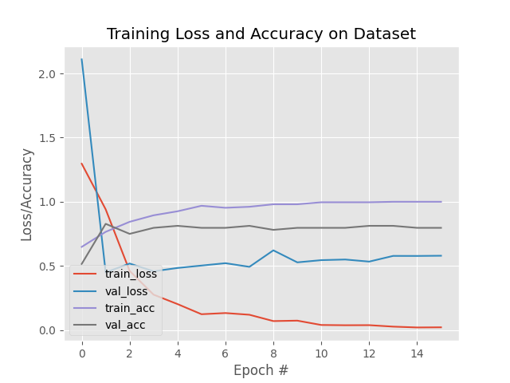
ResNet50 Model Results
Validation Accuracy: 84.375 %
F1 Score: 0.84
Cohen Kappa: 0.6875
Confusion Matrix: Loss Graph:
Actual
Actual
n = 64 | Positive | Negative
Positive | 26 | 6
Negative | 7 | 25
Predicted
Predicted

Slide 15
EfficientNet-B0
Grid search
In order to find the relationship between the different scaling dimensions of the baseline network, such as depth, width and resolutions, the appropriate scaling factor for each dimension are searched to expand the model.
New baseline model
In order to further improve performance, the author use the AutoML MNAS framework to perform neural structure search. The final architecture uses mobile reverse bottleneck convolution (MBConv).

Slide 16
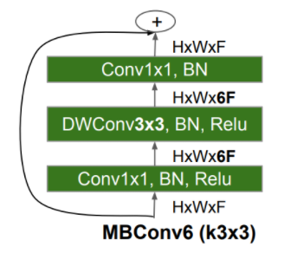
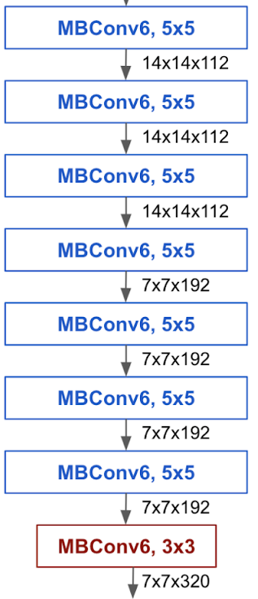
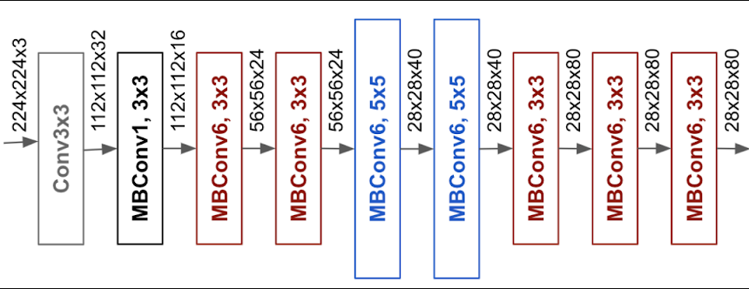
EfficientNet-B0 Description
Convolutional Neural Network
Pretrained on Imagenet Dataset
Input shape of (224,224), but our input of (100,100) works well too

Slide 17
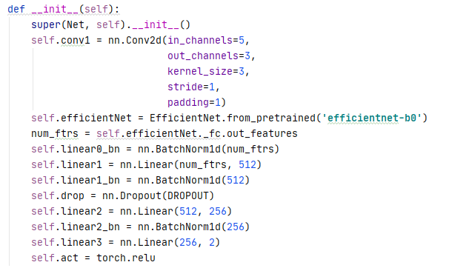
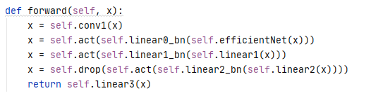
EfficientNet-B0 Model
Setup
Input Shape: (28,100*100,5)
Train/Test: 200/60 videos
Network

Slide 18
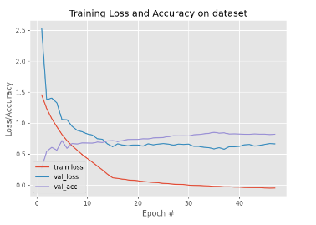
EfficientNet-B0 Model Results
Validation Accuracy: 79.165 %
Confusion Matrix: Loss Graph:
Actual
Actual
n = 229 | Positive | Negative
Positive | 105 | 18
Negative | 32 | 74
Predicted
Predicted

Slide 19
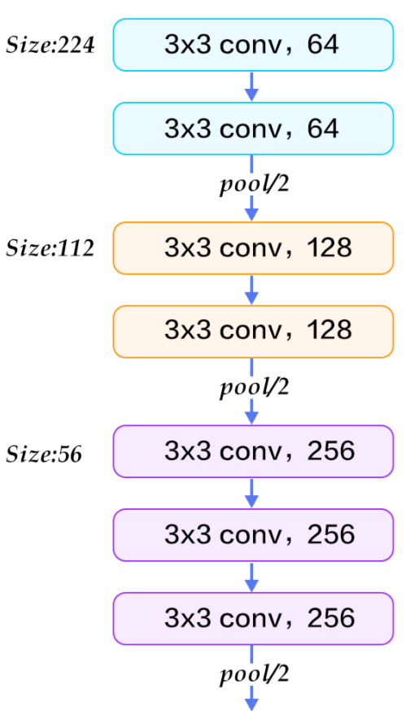
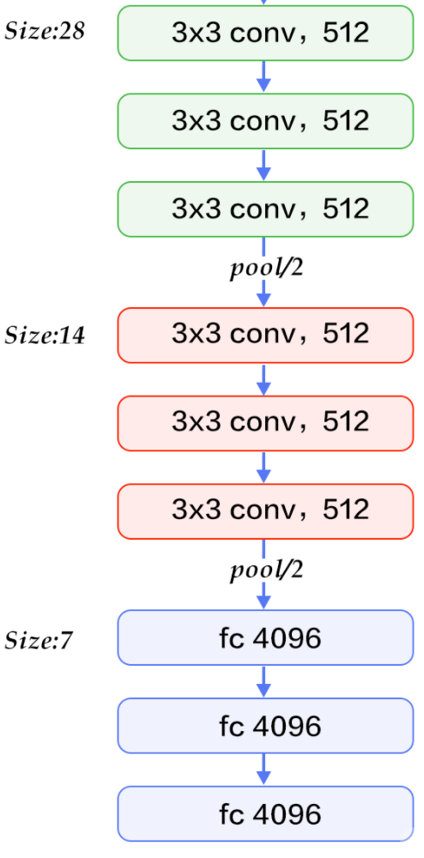
VGG-16 Description
Convolutional Neural Network
Pretrained on Imagenet Dataset
Input shape of (224,224), but our input of (100,100) works well too

Slide 20
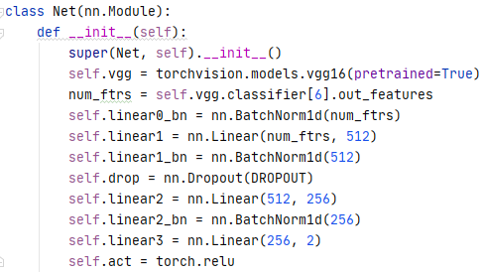
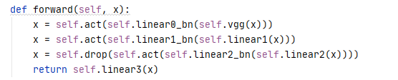
VGG-16 Model
Setup
Input Shape: (28,100*100,5)
Train/Test: 200/60 videos
Network

Slide 21
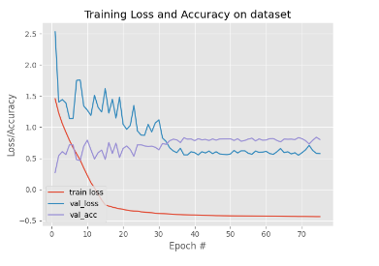
VGG-16 Model Results
Validation Accuracy: 83.406 %
Confusion Matrix: Loss Graph:
Actual
Actual
n = 229 | Positive | Negative
Positive | 112 | 11
Negative | 22 | 79
Predicted
Predicted

Slide 22
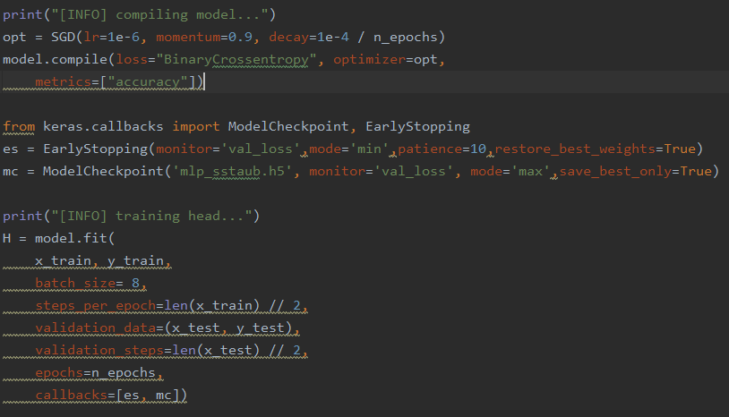
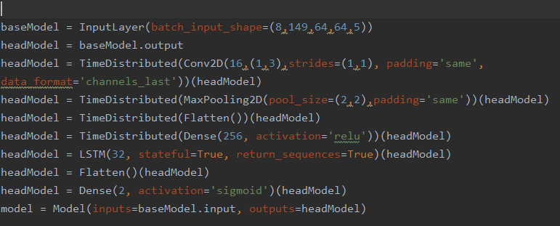
Time Distributed Conv2D with LSTM Model
Setup
Input Shape: (8,149,64,64,5)
Train/Test: 64/16 videos
Network

Slide 23
Time Distributed Conv2D with LSTM Model Results
Validation Accuracy: 81.5 %
F1 Score: 0.74
Cohen Kappa: 0.5
Confusion Matrix: Loss Graph:
Actual
Actual
n = 16 | Positive | Negative
Positive | 7 | 1
Negative | 3 | 5
Predicted
Predicted

Slide 24
Summary
Conclusion
Limitation
Improvement

Slide 25
Conclusion
Multilayer Perceptron and Conv1D are not accurate given its 2-dimension input
Trains on every frame
Conv2D is more accurate given its 3-dimension input
Trains on every frame per video at a time
Pretrained ImageNet Convolutional Neural Networks have better accuracy
Time Distributed Convolution Neural Networks could be most accurate given its 4-dimension input
Trains every image per layer per video at a time
Time Distributed Convolution Neural Networks with Long Short-Term Memory
Gives a relationship between frames of a video.

Slide 26
Limitations
Enormous size of the database ~120GB
Must reduce size and take a random sample of videos
Only used one GPU
Limited memory and computing power
Reduces accuracy and creates unstable networks (varying accuracies and loss)
Video Quality
Dark Environments
Low Resolution
Low Frames Per Second
Quick Moving Objects
Classifying frames vs classifying videos

Slide 27
Improvement
Video Augmentation and preprocessing
Addition GPUs and processing power for the Virtual Machine
Additional exploration of RNN/LSTM
Classification output by frame

Slide 28
Research
Raw dataset and some sample code
https://github.com/mchengny/RWF2000-Video-Database-for-Violence-Detection
Time Distributed and LSTM
https://medium.com/smileinnovation/how-to-work-with-time-distributed-data-in-a-neural-network-b8b39aa4ce00
Video Classification with Keras
https://www.pyimagesearch.com/2019/07/15/video-classification-with-keras-and-deep-learning/
Violence Detection with LSTM
https://www.worldscientific.com/doi/pdf/10.1142/S2196888820500013
5 Video Classification Methods
https://blog.coast.ai/five-video-classification-methods-implemented-in-keras-and-tensorflow-99cad29cc0b5

Slide 29
Reference
Ming Cheng, Kunjing Cai, and Ming Li. "RWF-2000: An Open Large Scale Video Database for Violence Detection." arXiv preprint arXiv:1911.05913 (2019).

Slide 30
Questions?

